Slide 1


Automated Credit Scoring System Using AI
MUSHFIQUS SALEHIN ABID(4367253)
VARUN SONY(4369885)
KC LENARDICH(4281349)
POOJITHA JEEVAN(4370918)
A Proposal for Enhanced Financial Decision-Making

Slide 2

Table of Contents
Introduction
Problem Statement
Value Proposition
Data Collection
Model Selection & Performance Metrics
Results & Comparison
Economic Impact & Monetary Value
Risks & Benefits
Implementation Pipeline
Conclusions

Slide 3
Introduction to AI in Credit Scoring
AI in Credit Scoring isn't just futuristic—it's now. We're leveraging machine learning to tackle the inaccuracies in traditional credit scoring, enhancing the speed and precision of risk assessments with powerful algorithms that learn from data.

Slide 4
Defining the Problem
The crux of current credit scoring woes? Latency, subjective judgments, and biases. These imperfections can culminate in financial mishaps like unwarranted loan defaults, which our AI solution is calibrated to mitigate

Slide 5
The Value Proposition
Introducing a system that's a blend of innovation and reliability—our AI-powered credit scoring app. It's designed to automate the assessment process, augment accuracy, and importantly, democratize financial decision-making.

Slide 6

Market Size and Potential Savings
With a vast number of transactions at stake, the financial services market is ripe for AI disruption. Our solution's precision in credit scoring can significantly reduce default rates, translating to massive savings across the industry.

Slide 7

Data Synthesis and Collection
Our synthetic data is the bedrock of our AI model—a carefully constructed dataset designed to echo the intricacies of real-world financial data without compromising individual privacy.

Slide 8
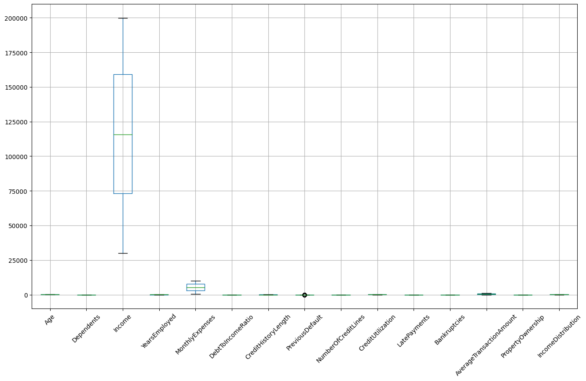
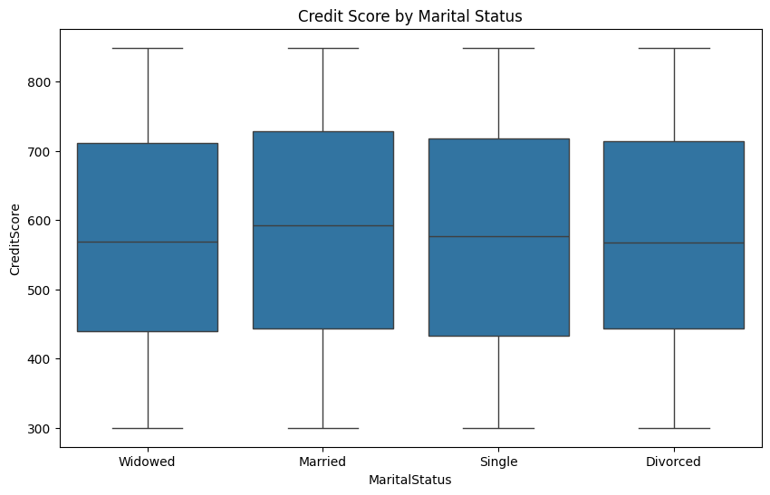
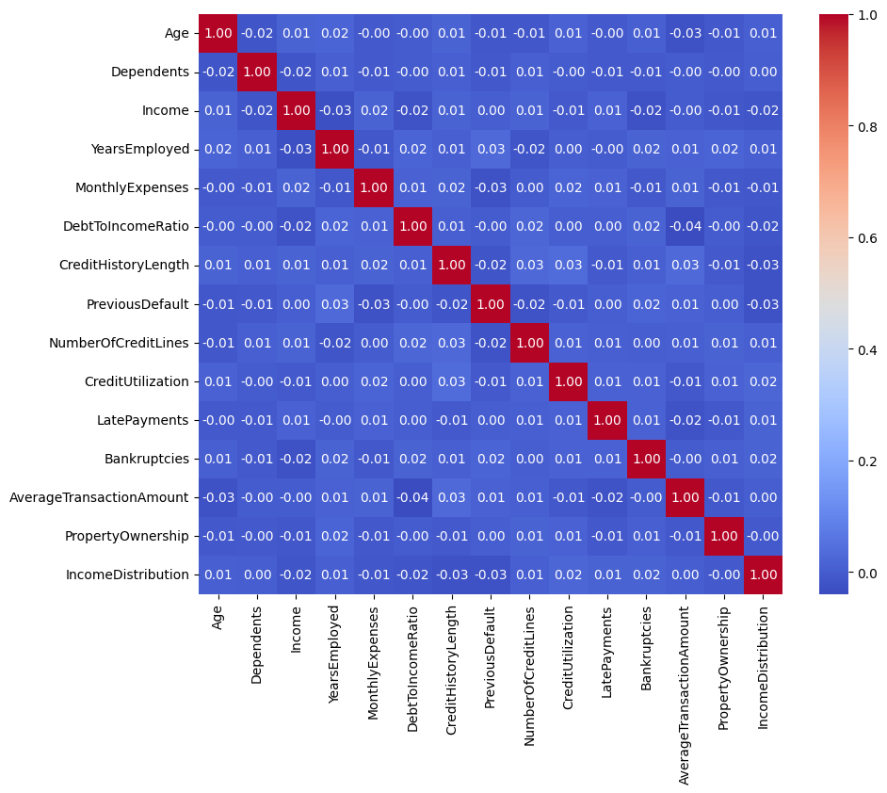
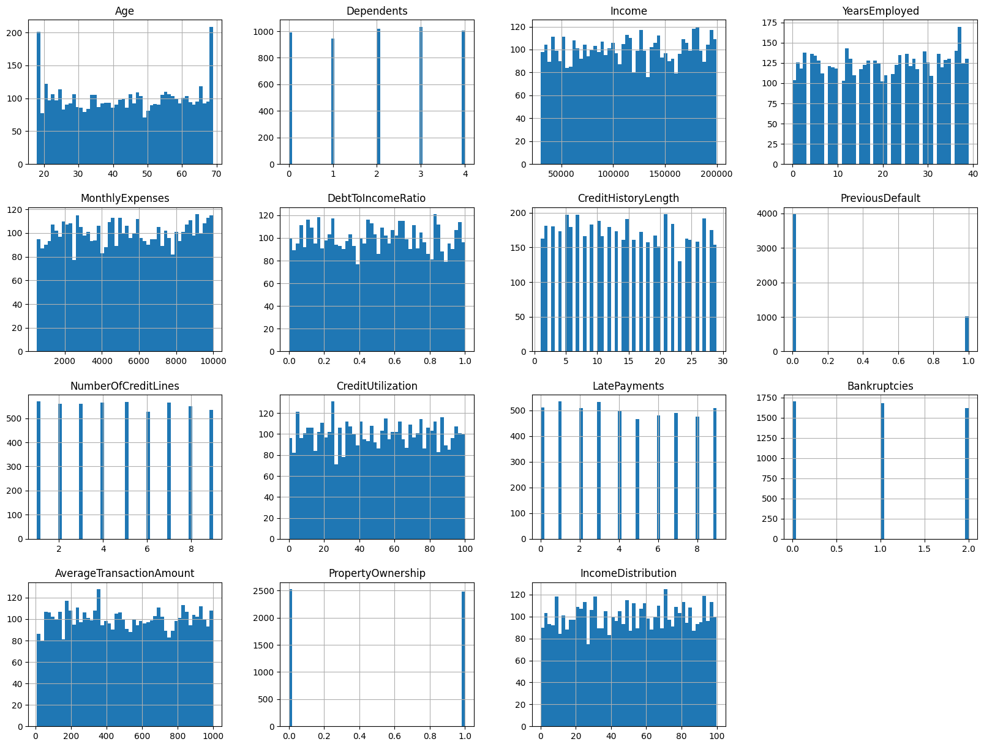
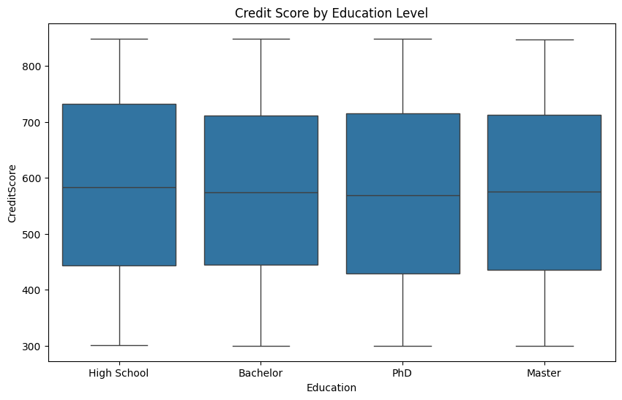

Slide 9

Methodology Overview
Our methodology's cornerstone is a robust analysis, enabling the cultivation of models equipped to extrapolate nuanced patterns from data.

Slide 10

Model Selection and Initial Analysis
We embarked on a comparative model analysis to select our best performer for credit scoring."
"A suite of models including KNN, Logistic Regression, SVM, RandomForest, and a Voting Classifier were evaluated."
"Each model underwent a thorough vetting process utilizing a pipeline incorporating preprocessing and PCA, followed by cross-validation to ensure unbiased performance assessment."
"The performance varied, with Logistic Regression, SVM, and Voting Classifier achieving a mean accuracy of around 72%, presenting them as front-runners."
"To hone in on the ideal candidate, we conducted hyperparameter tuning via GridSearchCV, refining the models to their peak performance."
"The Logistic Regression model emerged with the most promising hyperparameters, offering the best balance between accuracy and complexity.

Slide 11
KNN
Mean Accuracy: 0.6601 (Std: 0.0176)
Logistic
Regression
Mean Accuracy: 0.7230 (Std: 0.0010)
SVM
Mean Accuracy: 0.7230 (Std: 0.0010)
Random Forest
Mean Accuracy: 0.7104 (Std: 0.0081)
Voting
Voting: Mean Accuracy: 0.7230 (Std: 0.0010)

Slide 12
Final Selection:
"After thorough analysis and tuning, both Logistic Regression and SVM emerged as top performers. Logistic Regression was selected for its superior interpretability, which is crucial in financial applications where stakeholders require clarity on decision processes. Meanwhile, SVM was also optimized for its ability to effectively model non-linear relationships in high-dimensional spaces."
"Chosen Hyperparameters:
Logistic Regression: C=0.1, solver=saga
SVM: C=0.1, kernel=rbf"
"These models stood out for their robust performance and will be used in parallel to harness their respective strengths, ensuring our credit scoring system is both accurate and comprehensible."

Slide 13
Evaluating Performance Metrics
"Our evaluation framework isn't merely about percentages. It's about the stories numbers tell—stories of hits, misses, and near misses. By employing a nuanced range of performance metrics, we strive to paint a complete picture of our models' predictive prowess and their real-world implications."
"Accuracy alone can be misleading, particularly in imbalanced datasets. Hence, we delved deeper, employing precision, recall, and the F1-score to truly understand our models."
"For Logistic Regression, the precision tells us about its impeccable accuracy when predicting defaults, a significant achievement. Yet, the recall points to an opportunity—improving the model's ability to detect all potential defaults."
"Our SVM model's evaluation underscores a critical learning curve. Its lack of precision in predicting defaults suggests a need for recalibration, prompting us to reconsider feature selection, model parameters, or even the model itself."

Slide 14
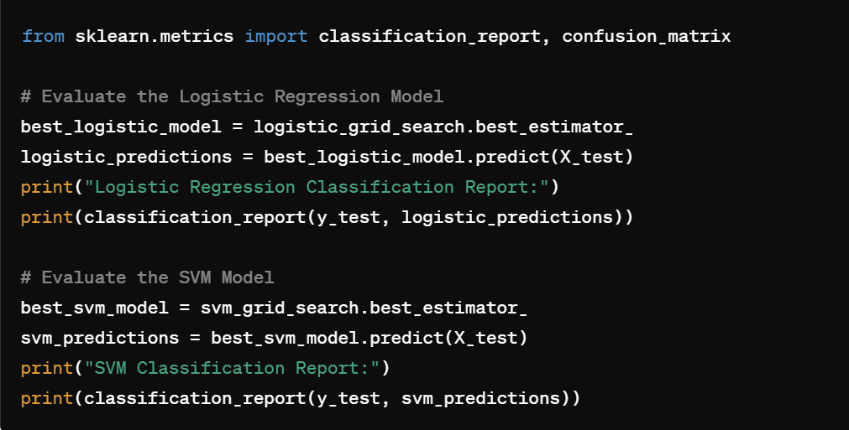
Code Snippet:

Slide 15
Model Performance Comparison
"In our head-to-head comparison, Logistic Regression showed superior accuracy and precision, especially when predicting loan defaults, with a remarkable 70% accuracy rate."
"SVM, while strong in handling non-linear data patterns, fell short in precision and recall for defaults, achieving only 65% accuracy. This underlines the importance of model selection based on specific performance criteria tailored to the task."

Slide 16
Precision and Recall
Our analysis further revealed that Logistic Regression, while flawless in precision (100% for defaults), suffers significantly in recall (14%), indicating a high number of missed defaults."
"The stark contrast in SVM's performance, with 0% precision for defaults, highlights its struggles with this particular dataset, signaling the need for further tuning and potentially different feature engineering strategies.

Slide 17
Economic Impact Analysis
"By reducing default rates through more accurate predictions, our AI model can save substantial amounts for lenders. For instance, preventing just 50 defaults on $200,000 loans results in direct savings of $10 million."
"These savings reflect not just a reduction in financial losses but also an opportunity to allocate resources more effectively across other areas of the business."

Slide 18

Risk Assessment and Management
"Risk management is pivotal. We prioritize mitigating model bias to ensure fair and equitable loan decisions. Regular audits and adherence to GDPR are integral to our operational protocols."
"The balance between predictive accuracy and ethical considerations forms the cornerstone of our approach to deploying AI in sensitive financial areas."

Slide 19

AI Implementation Pipeline
Our AI pipeline is comprehensive, from data preprocessing and feature engineering to model training and hyperparameter tuning, each step designed to refine and enhance model accuracy and reliability."
"Feature engineering is particularly critical, as it transforms raw data into a format that significantly improves model performance

Slide 20
Results and Model Comparison
Our final testing phase showed Logistic Regression outperforming SVM in both training and unseen data. This underscores its suitability for deployment in real-world credit scoring systems."
"Future work will focus on enhancing SVM's recall and exploring ensemble methods to leverage strengths from multiple models.

Slide 21

Conclusion and Future Directions
This project is a stepping stone towards revolutionizing credit scoring through AI. By continuously refining our models and integrating new data sources, we aim to build even more robust systems."
"Future directions include experimenting with newer algorithms, improving data collection methods, and further engaging with stakeholders to refine our understanding of the financial landscape.

